Slide 1
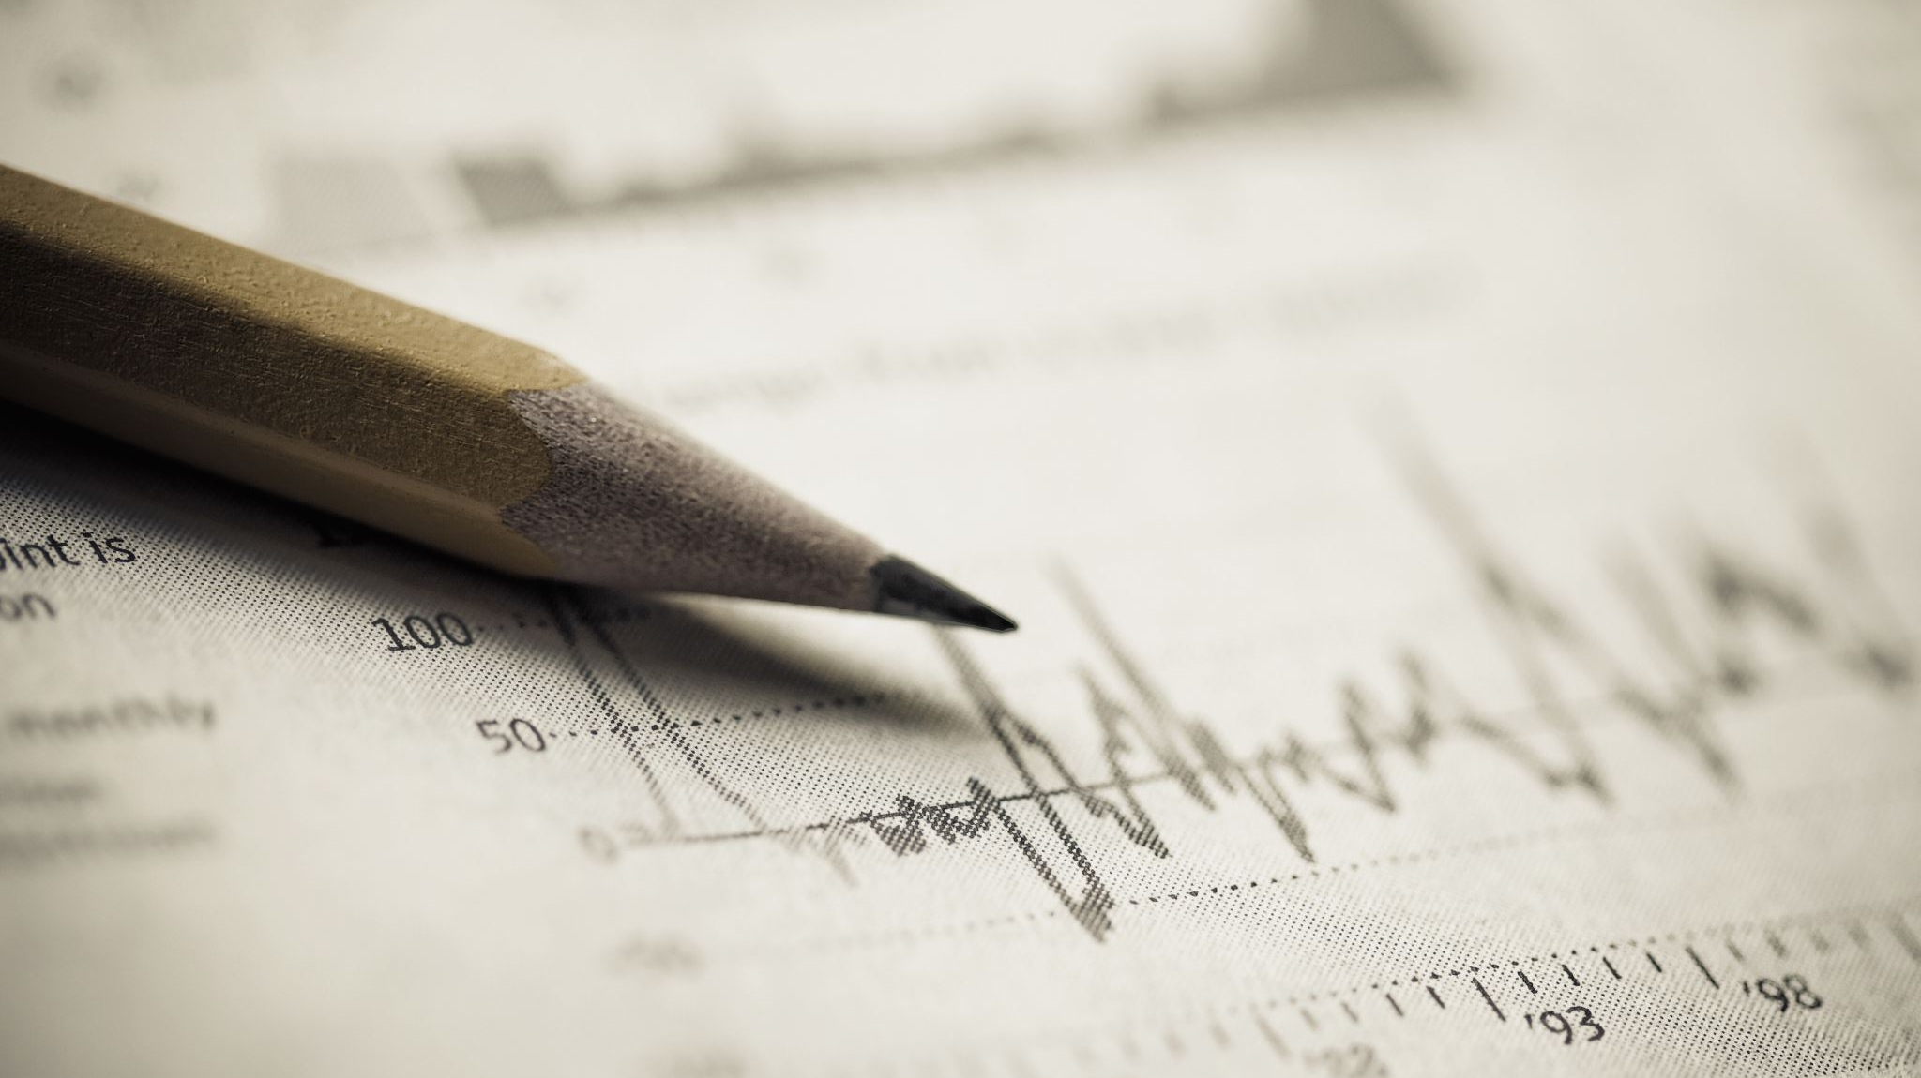
Handwritten Text Recognizer
- John Jim Evans Veernapati
Notes:
Hello Everyone, I am John Jim Evans Veernapati. This video gives the progress in my Capstone project. As I have mentioned in my proposal, I am trying to detect the handwritten text on cheques to help avoid the manual errors. A major change would be extending the project to detect more handwritten words. So, I had to change my project name.

Slide 2
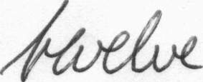

Data Source
IAM Handwritten Text Database 3.0
657 writers contributed samples of their handwriting
115'320 isolated and labeled words
Approximately 1 GB
Pictures of the words
Sample Data
Link
http://www.fki.inf.unibe.ch/databases/iam-handwriting-database/iam-handwriting-database#icdar02
Notes:
For the data source, I have looked for hand written database and found this data source interesting. IAM Handwritten Text Database has over 1 lakh words labelled and are contributed by 657 writers. The words are extracted from scanned written texts and are manually labeled. These words are stored in the form of pictures. The size of the data is approximately 1 GB. Here are the examples of the pictures of the words. The link to the data source is down below. We have to register on the site to access the data. I will also add the link to data source in the description section of this video.

Slide 3
STATUS SO FAR
Cleaning and taking the required Images
Preprocessing the Images
- Images are of different sizes
- Padded the edges to bring all the images to the same sizes
Built a simple convolution linear model with two layers, to see if the data can be processed
Notes:
The goal of my project is to build an application which can scan the handwritten text on a cheque and identify this text.
Why I chose this project?
As I told earlier, the cost of manual errors would be huge. So this application can play a significant role in reducing the manual errors. This application can also be used by a number of banks.

Slide 4
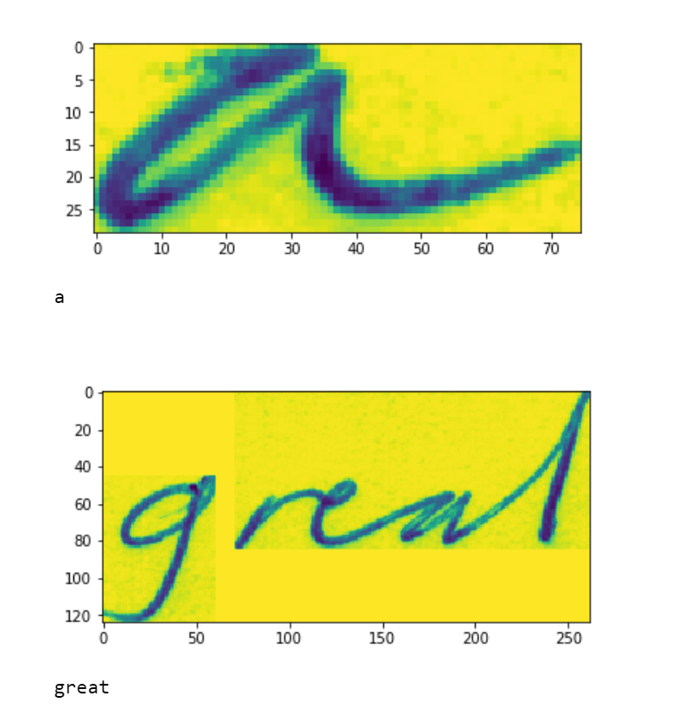
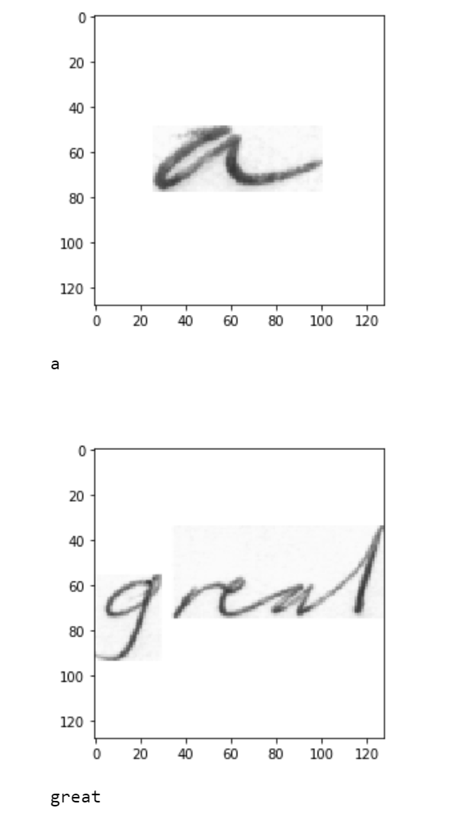
Before Processing After Processing

Slide 5
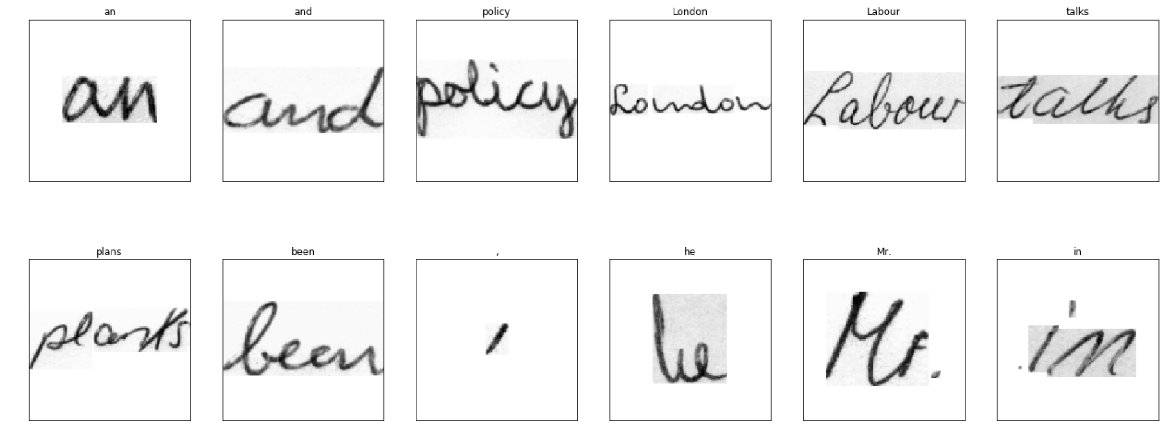
More Images

Slide 6
PROBLEMS TACKLED
The first problem tackled was the problem of sizes (Brought all the images to 128x128 size frame)
Second problem is the labels being text
Tensors cannot accept the labels being in text
Tried changing the labels into ascii sequence (As word increases the length of the sequence increases by 3 times, so we get long type)
Since Tensors cannot handle long type, dropped that idea
Changed the labels using a iterator of numbered sequence
Labels are around 13518 (Too many classes to identify)
Too many images and labels to solve a classification problem
Computational Problem (Would try finding free servers to train data/use colab to train the model)

Slide 7
Results So far
Results so far are poorer to tackle the classification problem, since the classification was done on less labels
To improve results, train more data and use better label tackling approach
Implementation Methodology: (Tentative)
Clean and preprocess the words images
Link the word pictures with the labeling
Trying to tackle a classification problem as of now
Build a neural network
Identify the words and give them a spell check to improve accuracy
Tech Stack
Python – Machine Learning Algorithms
Flask – Web Application
Notes:
Here is the implementation methodology that I am looking at. Note that this is the temporary. Any ideas would be highly appreciated. In brief I would have to build the network using Neural networks. It can be any of CNN/RNN/LSTM Networks. After building the network, I will identify the words on the cheque using OpenCV and Google Teserract! As I am planning to build an application, it would be a web application where I would try to visualize the results.
For the Tech Stack, for machine learning - I would be using python and for the application development I would want to use flask.

Slide 8
Changes from Proposal
I am trying to extend my project to detect handwritten words rather than sticking to only the cheques
Given that I will still include the tesseract code to detect the bar codes in the cheque
Next Steps
Build an efficient Neural Network Algorithm
Try Torch Text to handle the labels
Build an interface to interact with the algorithm
Display the results
Notes:
This slide shows the low level architecture of my project. Handwritten text images are processed and neural network is built on these images. Prediction is done on the handwritten words that are extracted from the cheques.
Webapplication would have an option to upload the cheque and the machine learning algorithm runs on the image and the results are displayed on the webapp.

Slide 9


Thank you
Questions and Feedback?
jimevans.v@umbc.edu
https://github.com/jimevansv/Data_606

